Slide 1
TAX REFORM

Slide 2
QUINPOOL ROAD BID

Slide 3
BREAKDOWN OF QUINPOOL ROAD DATA
Number of properties in Quinpool Road BID – 95
2015 Total Assessment for the BID: $79,771,500
Total Area of the BID: 808,187 Square Foot
Average Assessment per square foot: $98.70
 | $1M AND ABOVE | $500,000-$1M | $200,000-$500,000 | BELOW $200,000
NUMBER OF PROPERTIES | 16 | 38 | 32 | 19
Percent of Properties | 15% | 36% | 31% | 18%
TOTAL ASSESSMENT | $47,767,400 | $17,873,800 | $11,324,100 | $2,806,200
Percent of Total Assessment | 60% | 22% | 14% | 4%
Average Assessment per square foot | $114.14 | $153.71 | $54.18 | $43.58

Slide 4
QUINPOOL ROAD BID
2015 ASSESSMENT
NUMBER OF PROPERTIES

Slide 5
DOWNTOWN DARTMOUTH BID

Slide 6
BREAKDOWN OF DOWNTOWN
DARTMOUTH DATA
Number of properties in Downtown Dartmouth BID – 147
2015 Total Assessment for the BID: $86,337,900
Total Area of the BID: 2,711,898 Square Foot
Average Assessment per square foot: $31.84
 | $1M AND ABOVE | $500,000-$1M | $200,000-$500,000 | BELOW $200,000
NUMBER OF PROPERTIES | 10 | 17 | 50 | 70
Percent of Properties | 7% | 11% | 34% | 48%
TOTAL ASSESSMENT | $50,478,000 | $11,990,900 | $16,584,600 | $7,284,400
Percent of Total Assessment | 59% | 14% | 19% | 8%
Average Assessment per square foot | $73.13 | $26.57 | $13.15 | $23.57

Slide 7
DOWNTOWN DARTMOUTH BID
2015 ASSESSMENT
NUMBER OF PROPERTIES

Slide 8
DOWNTOWN HALIFAX BID

Slide 9
BREAKDOWN OF DOWNTOWN HALIFAX DATA
Number of properties in Downtown Halifax BID –182
2015 Total Assessment for the BID: $1,064,978,600
Total Area of the BID: 3,897,896.15 Square Foot
Average Assessment per square foot: $273.22
 | $1M AND ABOVE | $500,000-$1M | $200,000-$500,000 | BELOW $200,000
NUMBER OF PROPERTIES | 87 | 39 | 34 | 22
Percent of Properties | 48% | 21% | 19% | 12%
TOTAL ASSESSMENT | $1,021,992,400 | $29,146,100 | $11,000,400 | $2,839,700
Percent of Total Assessment | 96% | 3% | 1% | 0%
Average Assessment per square foot | $301.38 | $94.29 | $82.45 | $44.10

Slide 10
DOWNTOWN HALIFAX BID
NUMBER OF PROPERTIES
2015 ASSESSMENT

Slide 11
NORTH END BID

Slide 12
BREAKDOWN OF NORTH END DATA
Number of properties in North End BID – 228
2015 Total Assessment for the BID: $97,305,100
Total Area of the BID: 1,451,500 Square Foot
Average Assessment per square foot: $67.04
 | $1M AND ABOVE | $500,000-$1M | $200,000-$500,000 | BELOW $200,000
NUMBER OF PROPERTIES | 21 | 25 | 78 | 104
Percent of Properties | 9% | 11% | 34% | 46%
TOTAL ASSESSMENT | $46,038,800 | $16,207,900 | $24,232,100 | $10,826,300
Percent of Total Assessment | 47% | 17% | 25% | 11%
Average Assessment per square foot | $91.60 | $79.25 | $58.91 | $32.51

Slide 13
NORTH END BID
2015 ASSESSMENT
NUMBER OF PROPERTIES

Slide 14
SPRING GARDEN BID

Slide 15
BREAKDOWN OF SPRING GARDEN DATA
Number of properties in Spring Garden BID – 72
2015 Total Assessment for the BID: $151,383,700
Total Area of the BID: 517,587.60 Square Foot
Average Assessment per square foot: $292.48
 | $1M AND ABOVE | $500,000-$1M | $200,000-$500,000 | BELOW $200,000
NUMBER OF PROPERTIES | 30 | 18 | 15 | 9
Percent of Properties | 42% | 25% | 21% | 12%
TOTAL ASSESSMENT | $131,237,800 | $12,870,300 | $6,200,500 | $1,075,100
Percent of Total Assessment | 87% | 8% | 4% | 1%
Average Assessment per square foot | $336.10 | $144.64 | $209.98 | $125.01

Slide 16
SPRING GARDEN BID
NUMBER OF PROPERTIES
2015 ASSESSMENT

Slide 17
MAIN STREET DARTMOUTH BID

Slide 18
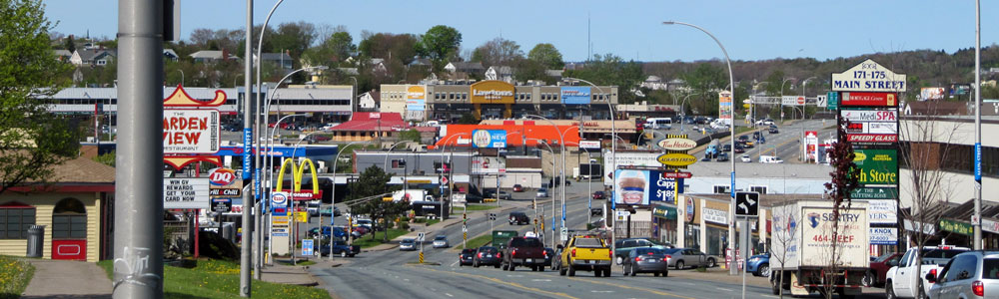
A Picture of Main Street Dartmouth BID

Slide 19
BREAKDOWN OF MAIN STREET
DARTMOUTH BID
Number of Properties in Main Street BID - 51
2015 Total Assessment for the BID: $72,206,700
Total Area of the BID: 3,046,904.20 Square Foot
Average Assessment per square foot: $23.70
 | $1M AND ABOVE | $500,000-$1M | $200,000-$500,000 | BELOW $200,000
Number of Properties | 13 | 17 | 12 | 10
Percent of Properties | 25% | 33% | 23% | 19%
Total Assessment | $54,963,500 | $12,087,200 | $4,509,800 | $646,200
Percent of Total Assessment | 76% | 17% | 6% | 1%
Average Assessment per square foot | $35.74 | $9.84 | $25.57 | $6.20

Slide 20
MAIN STREET DARTMOUTH BID
2015 ASSESSMENT
NUMBER OF PROPERTIES

Slide 21
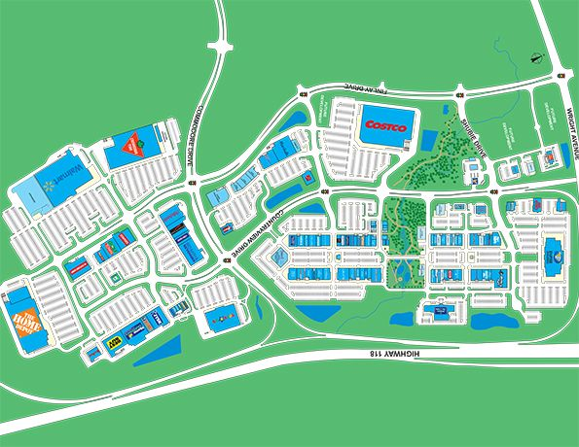
DARTMOUTH CROSSING

Slide 22
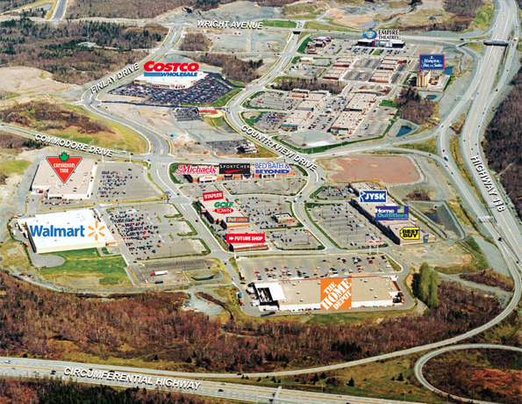
Picture of Dartmouth Crossing

Slide 23
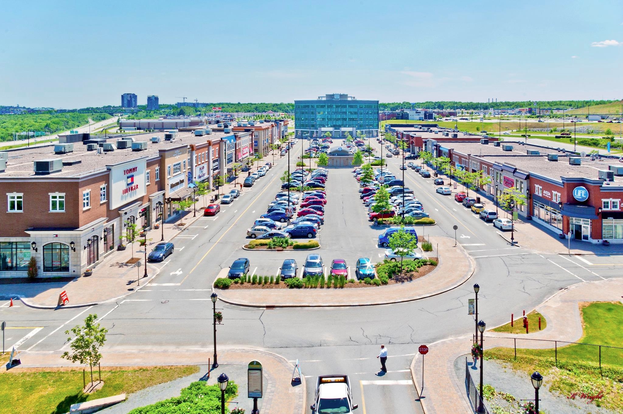
BREAKDOWN OF DARTMOUTH CROSSING DATA
Number of Properties in Dartmouth Crossing – 15
Total Assessment: $ 282,300,400
Total Area: 7,344,948 Square Foot
Average Assessment per square foot: $38.43
 | $1M AND ABOVE | $500,000-$1M | $200,000-$500,000
Number of Properties | 13 87% | 1 6.5% | 1 6.5%
Total Assessment | $281,088,500 100% | $990,700 0% | $221,200 0%
Average Assessment per square foot | $38.62 | $24.78 | $8.07

Slide 24
DARTMOUTH CROSSING BID
2015 ASSESSMENT
NUMBER OF PROPERTIES

Slide 25
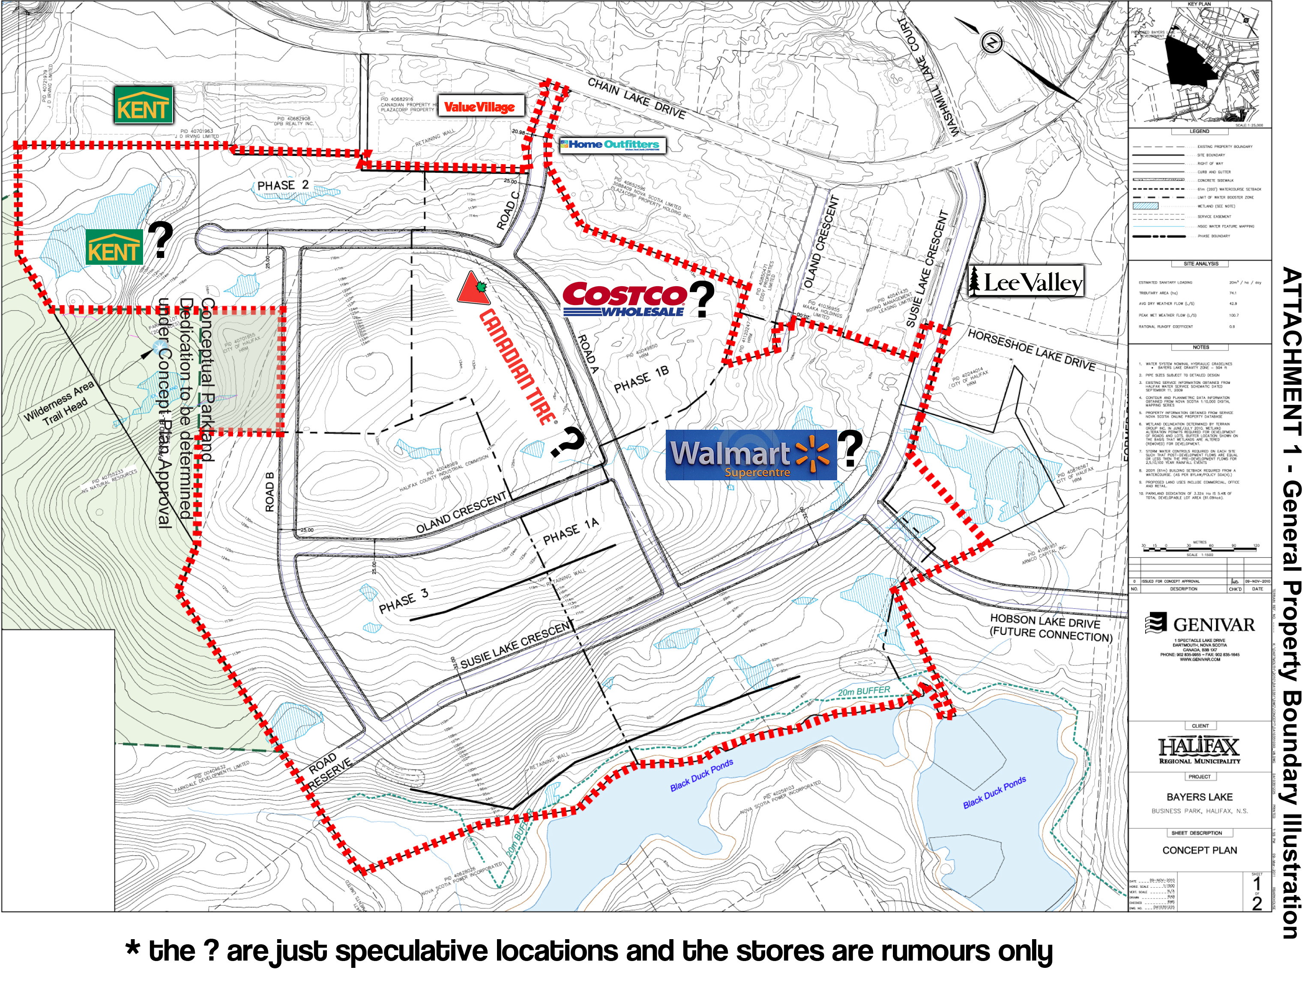
BAYERS LAKE

Slide 26
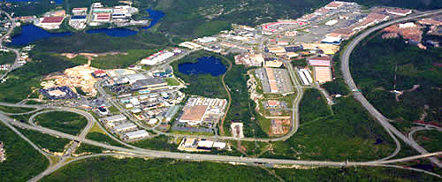

BREAKDOWN OF BAYERS LAKE DATA
Number of properties in Bayers Lake – 19
Total Assessment: $219,360,200
Total Area: 13,413,382 Square Foot
Average Assessment per square foot: $16.35
 | $1M AND ABOVE | $500,000-$1M
Number of Properties | 18 (95%) | 1 (5%)
Total Assessment | $218,628,200 | $732,000
Percent of Total Assessment | 100% | 0%
Average Assessment per square foot | $16.35 | $19.08

Slide 27
BAYERS LAKE
2015 ASSESSMENT
NUMBER OF PROPERTIES

Slide 28
AVERAGE ASSESSMENT PER SQUARE FOOT COMPARISON FOR EACH BID
BUSINESS AREAS | AVERAGE ASSESSMENT PER SQUARE FOOT | AREA (SQUARE FOOT)
BAYERS LAKE | $16.35 | 13,413,382
DARTMOUTH CROSSING | $38.43 | 7,344,948
MAIN STREET DARTMOUTH | $23.70 | 3,046,904
QUINPOOL ROAD | $98.70 | 808,187
DOWNTOWN HALIFAX | $273.22 | 3,897,896
DOWNTOWN DARTMOUTH | $31.84 | 2,711,898
SPRING GARDEN ROAD | $292.48 | 517,588
NORTH END | $67.04 | 1,451,501

Slide 29
ANNUAL ASSESSMENT RATE INCREASE:
BUSINESS AREAS | 2013-2014 | 2014-2015 | TOTAL
BAYERS LAKE | 11.59% | 6.43% | 18.02%
DARTMOUTH CROSSING | 13.02% | 11.92% | 24.94%
MAIN STREET DARTMOUTH | 2.85% | 4.25% | 7.10%
QUINPOOL ROAD | 6.44% | 8.05% | 14.49%
DOWNTOWN HALIFAX | 7.23% | 5.92% | 13.15%
DOWNTOWN DARTMOUTH | -1.12% | 14.54% | 13.42%
SPRING GARDEN ROAD | 6.44% | 1.43% | 7.87%
NORTH END | 6.64% | 5.32% | 11.96%

Slide 30
2015 ASSESSMENT BY CATEGORIES
1M AND ABOVE
500,000 – 1M
200,000 – 500,000
BELOW 200,000

Slide 31
NUMBER OF PROPERTIES BY CATEGORIES
1M AND ABOVE
500,000 – 1M
200,000 – 500,000
BELOW 200,000

